Slide 1
Technical Support (420-1N6-AB) Virtual Machines
Fall 2022

Slide 2
Outline
Virtual Machines Review
Hyper-V Introduction
Installing Hyper-V
Creating a Virtual Machine (VM)
VM Checkpoints
Nested Virtualization

Slide 3
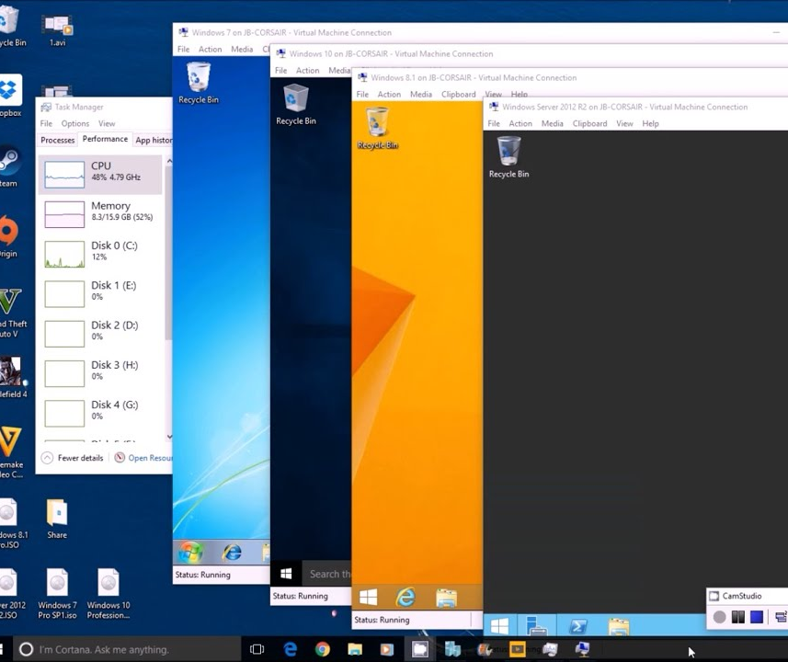
Virtualization & MS Hyper-V
As programmers or IT professional the need to run multiple operating systems is essential.
Why?
Experiment with other operating systems.
Run software that requires other operating systems or an older versions of Windows.
Test software on multiple operating systems.
Hyper-V a solution from Microsoft allows users to run multiple operating systems as virtual machines on Windows.

Slide 4
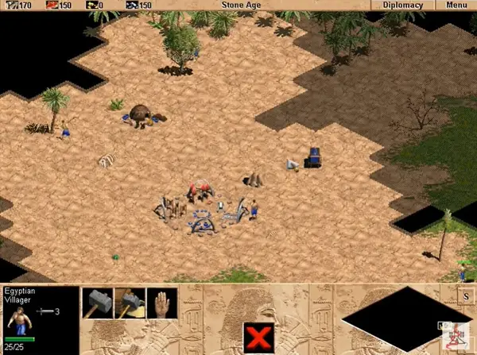
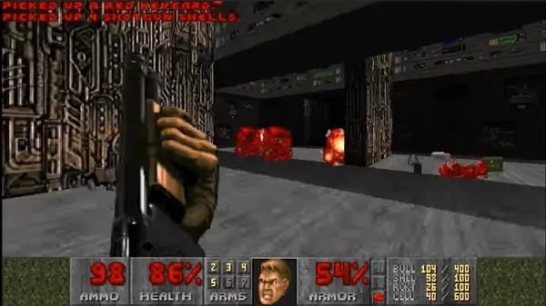
Older versions of Windows
Playing doom 1993 on Windows 98

Slide 5
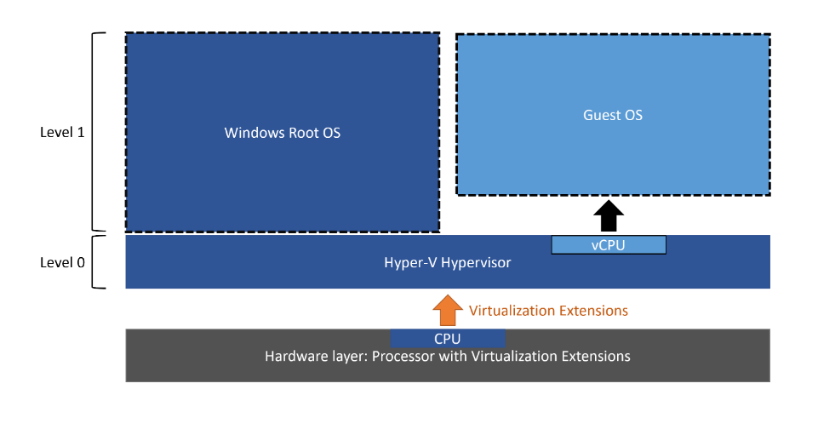
Hyper-V Architecture
Terms you should know:
Hypervisor:
Computer software, firmware, or hardware that creates and runs virtual machines
Host machine/OS:
The machine/operating system containing a hypervisor running one or more virtual machines
Guest machine/OS:
The virtualized operating system running on virtualized hardware provided by the hypervisor/host machine. I.e., the virtual machine (VM)
Client machine/OS:
The machine/operating system providing the UI/Shell interface for the guest operating system. Often, but not always, the same as the Host Machine.
Above: A Type-1 hypervisor, where the Hypervisor has been installed directly on the hardware of the computer, and a Windows OS acting as the host (see next slide for Type-1 vs Type-2 hypervisors).

Slide 6
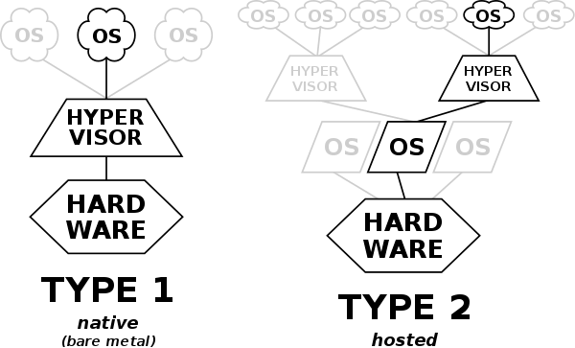
Hyper-V Architecture
Terms you should know:
Hypervisor Type 1:
These hypervisors run directly on the host's hardware to control the hardware and to manage guest operating systems. For this reason, they are sometimes called bare-metal hypervisors.
Hypervisor Type 2:
These hypervisors run on a conventional operating system (OS) just as other computer programs do. A virtual machine monitor runs as a process on the host. Type-2 hypervisors abstract guest operating systems from the host operating system.
Source (graphics and description): https://wikiless.org/wiki/Hypervisor

Slide 7
Hypervisors
There are many choices for hypervisor software, depending on the host operating system of your machine. These hypervisors vary in several important ways, notably in Image File Format. Hypervisors emulate hardware storage by saving a file of the following formats on your Host OS. Not all hypervisors are compatible with all image file formats. (see https://wikiless.org/wiki/Comparison_of_platform_virtualization_software for a comprehensive comparison)
Hypervisor | Host OS | Image file format
Hyper-V | Windows | VHD/VHDX, compatible with: ISO
Parallels | OS X | HDD, compatible with apparently no other image file formats
KVM/QEMU | Linux | QCOW, compatible with: literally every other image file format in theory
VirtualBox | Cross-platform | VDI, compatible with: literally every other image file format in theory
VMWare | Cross-platform | VMDK, compatible with: ISO

Slide 8
Hyper-V Installation Requirements
Windows Version:
Windows 10 Enterprise, Pro, or Education.
64-bit Processor with Second Level Address Translation (SLAT)
(https://en.wikipedia.org/wiki/Second_Level_Address_Translation)
CPU support for VM Monitor Mode Extension.
Minimum of 4 GB memory.

Slide 9
Creating a Virtual Machine (VM)

Slide 10
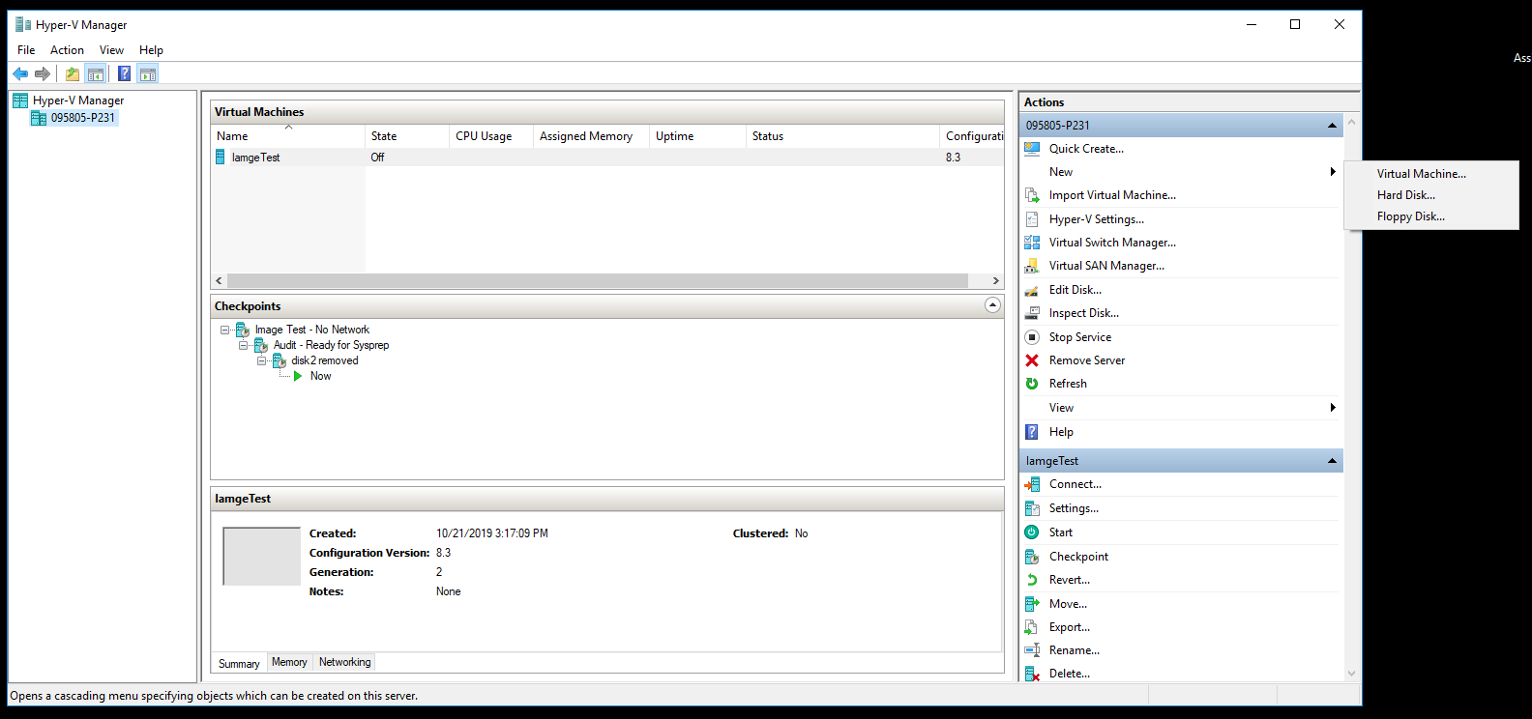
Creating a New VM

Slide 11
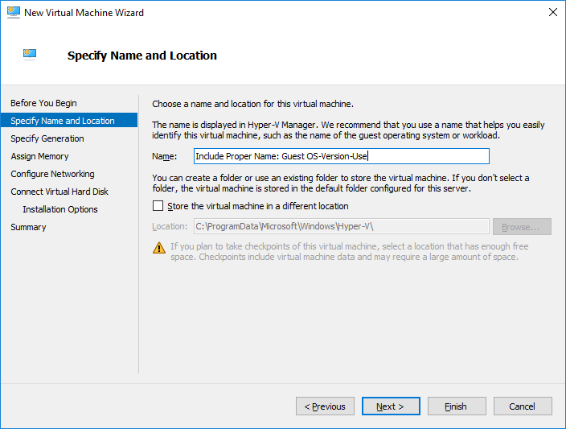
New VM Settings: Name and Location
Name:
Include host OS name and version.
Include VM purpose or use.
Change Location: Create a folder on your lab machine at the location C:\Users\<yourStudentID>\VirtualMachines, and choose this location.

Slide 12
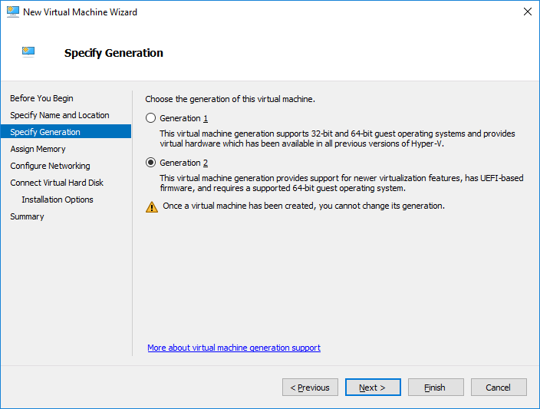
New VM Settings: VM Generations
There are two generations of Hyper-V VM:
Generation 1
Generation 2 (choose this)
The choice of VM generation depends on:
Host operating system
Guest operating system
Boot methods.

Slide 13
Advantages Generation 2 VMs
Higher performance
maximum 1 TB RAM for Generation 1 VMs vs 12 TB RAM for Generation 2 VMs;
maximum 64 virtual processors for Generation 1 VMs vs 240 virtual processors for Generation 2 VMs.
UEFI\BIOS Support
Higher maximum storage size/# of partitions
Higher security with Secure Boot and Trusted Platform Module.
More boot options:
PXE boot with synthetic network adapter for network booting
Support of both Legacy VHD virtual harddisks AND Extended VHDX virtual hard disks (higher maximum disk size).
Copying Files from Hyper-V Host to VMs without Network Connection of VMs.

Slide 14
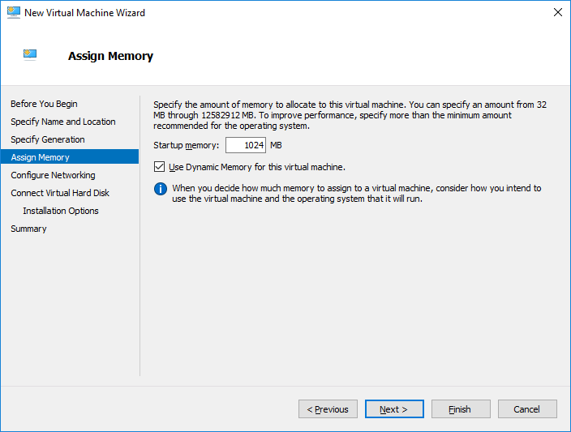
New VM Settings: Memory
New Virtual Machines must be allocated some amount of memory from RAM.
For our purposes, 4GB should be plenty (4000Mb)
Select “Dynamic Memory” if it is an option.

Slide 15
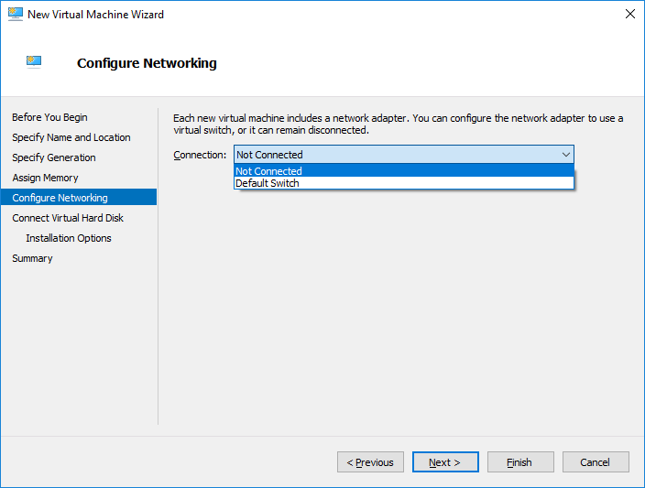
New VM Settings: Networking
Select “Not connected” nor now. We will configure the network switch later.

Slide 16
Virtual Networks & Switches
A VM will need a virtual network to share a network with the host computer.
Creating a virtual network is optional if the VM does not need to be connected to the internet or a network.
To create a virtual network, you need to create a virtual switch.
A virtual switch allows VMs created on Hyper-V hosts to communicate with other computers or VMs.

Slide 17
Types of Virtual Switches
External | Gives VMs access to a physical network to communicate with servers and clients on an external network. Allows VMs on the same Hyper-V server to communicate with each other.
Internal | Allows communication between VMs on the same Hyper-V server. Allows communication between the VM and the management host operating system.
Private | Only allows communication between VMs on the same Hyper-V server. A private network is isolated from all external network traffic on the Hyper-V server.

Slide 18
Creating a Virtual Switch
A default virtual switch is created when installing Hyper-V.
The default virtual switch uses an internal networking setting.
To add another virtual switch
Open Hyper-V Manager
Select the Hyper-V host computer name. (right-hand side)
Select Action > Virtual Switch Manager.
Choose the type of virtual switch.
Select Create Virtual Switch.

Slide 19
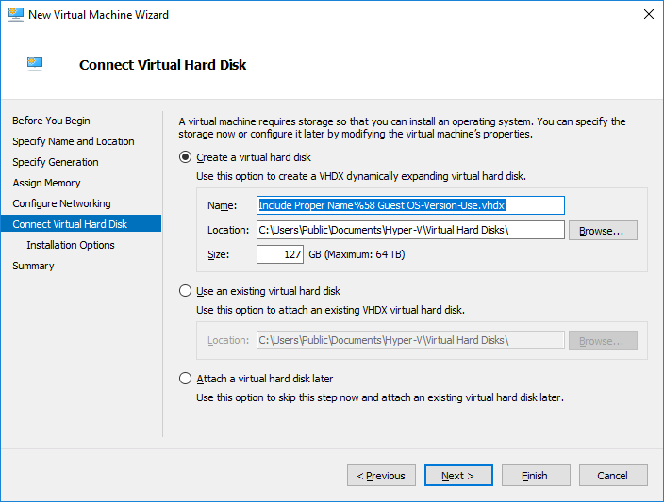
New VM Settings: Hard Disk
VHDs are virtualized hard disk files.
Once mounted to an OS, they will appear and operate pretty much identically to a physical hard drive.
A VHD is commonly accessed, managed and installed on VMs.
For our purposes, 50GB should be plenty

Slide 20
VHDX
VHDX is a new virtual hard disk format introduced in Windows Server 2012.
Support for virtual hard disk storage capacity of up to 64 terabytes.
Protection against data corruption during power failures by logging updates to the VHDX metadata structures.
Ability to store custom metadata about a file, which a user might want to record, such as operating system version or patches applied.

Slide 21
Types of VHD
Fixed virtual hard disk
VHD size is allocated when the VHD file is created.
Recommended on VMs that require many I/O operations.
Dynamic virtual hard disk
Space for the VHD is allocated on demand.
The blocks in the disk start as unallocated blocks and are not backed by any actual space in the file.
Differencing virtual hard disk
Points to a parent VHD file.
Contains block data that represents changes to a parent VHD.
Changes can be reversed if necessary.

Slide 22
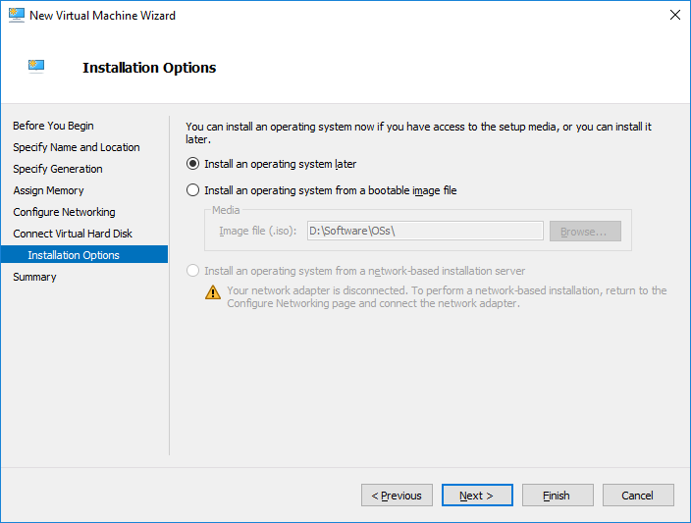
New VM Settings: OS Installation
An OS can be installed on VM using an ISO file of the OS.
Use the Windows ISO from the class USBs
OS installation can be done through other boot option later.
Network boot.
Attached bootable devices.

Slide 23
Final steps
Next -> Finish to create the VM.
The created VM will show in the Hyper-V Manager. Right-Click and open the VM Settings. Apply the following modifications:
Processor: Number of virtual processors: 2.
Checkpoints: Standard Checkpoints (unselect Use automatic checkpoints)
Press OK to Save the VM settings.
Launch VM
Start VM (Green One button)
Set the language, time and currency formats and keyboard 🡪 Next
Install Now.
Windows 10 Educational.
I don’t have a product key.
I accept the license terms.
Custom install
Disk: Partition Disk 0 into partitions using the New button. Create a 30 GB partition.
Format the partitions
Choose the 30 GB partition to install Windows 10.
Allow Windows 10 to copy the file and install.
Once the process is done, DO NOT proceed with the setup.
Here, we will add a checkpoint. Best practise: turn OFF your VM before making a checkpoint
Add a checkpoint: Action menu -> Checkpoint
(the checkpoint will allow come back to this point if any error happens at a later stage)
Provide a name for the checkpoint: Image-Test No Network
Check the Hyper-V Manage to ensure that checkpoint has been created. The progress will be shown, and checkpoint will appear in the Checkpoints list.
about checkpoints: Only make checkpoints when VM is turned off, in a stable state (not in the middle of something). Also, make checkpoints sparingly. You should only have one or two at a time -- they take up a lot of space! Delete old checkpoints when they are no longer of utility to you. See here: https://www.youtube.com/watch?v=NW4UQHYFeCw
After these steps have been done:
Ensure that the location of the image is where you set the location (see the slide about VM settings: harddrive)
IF you have your external harddrive with you:
Plug it into your lab machine
in Hyper-V, Export your new virtual machine to your external harddrive.
In future labs, you will be able to Import your virtual machine in order to use it on other computers.

Slide 24
VM Checkpoints

Slide 25
What are VM Checkpoints?
A VM checkpoint is a saved state of the virtual machine.
Checkpoints in Hyper-V are used to revert virtual machines to a previous state.
Checkpoint are usually created before:
Making software configuration changes.
Applying a software update
Installing new software.
If the changes added to the system were to cause any issue, the virtual machine can be reverted to the state at which it was when then checkpoint was taken.

Slide 26
Checkpoint Types
Standard Checkpoints
Takes a snapshot of the VM and VM’s memory state.
A snapshot is not a full backup.
Production Checkpoints:
Creates a data-consistent backup of the virtual machine.
The VM’s memory snapshot is not taken.

Slide 27
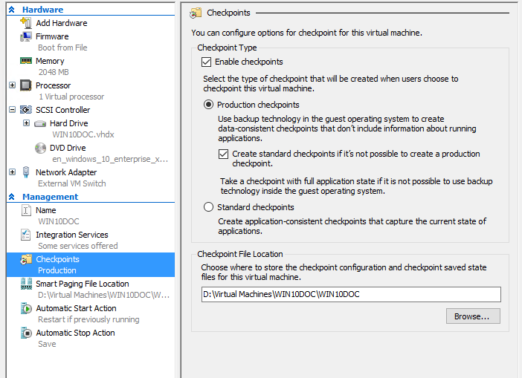
Changing Checkpoint Type
Open Hyper-V Manager.
Right click on a virtual machine and select settings.
Under Management select Checkpoints.
Select the desired checkpoint type. Let’s select Production for now.

Slide 28
Creating Checkpoints
In Hyper-V Manager, select the virtual machine.
Right-click the name of the virtual machine, and then click Checkpoint.
When the process is complete, the checkpoint will appear under Checkpoints in the Hyper-V Manager.
Note: The created checkpoint will be of the type configured for the virtual machine settings.

Slide 29
Applying a Checkpoint
In Hyper-V Manager, select the virtual machine.
In the Checkpoints section, right-click the checkpoint that you want to use and click Apply.
A dialog box appears with the following options:
Create Checkpoint and Apply: Creates a new checkpoint of the VM before it applies the earlier checkpoint.
Apply: Applies only the checkpoint that you have chosen. You cannot undo this action.

Slide 30
Nested Virtualization

Slide 31
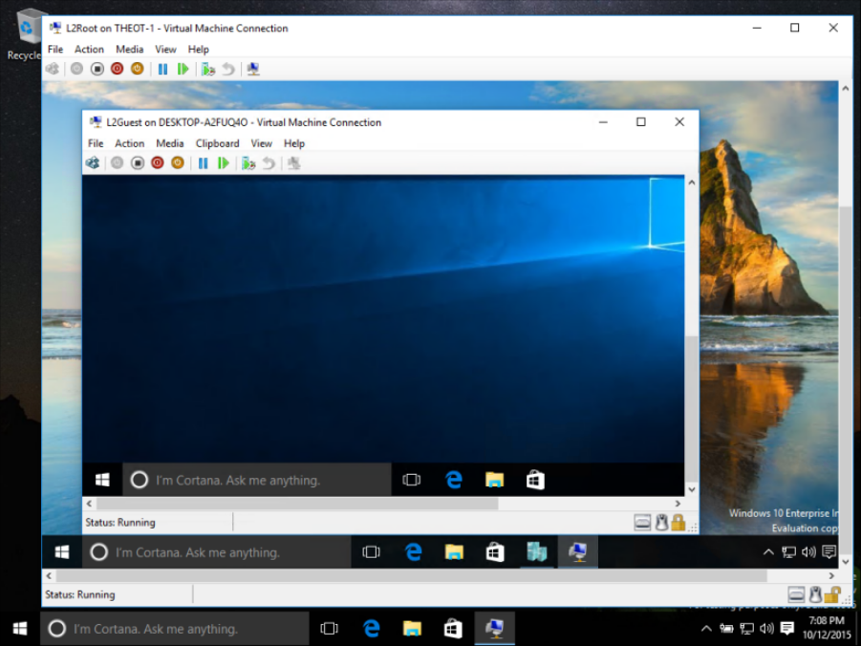

Slide 32
Nested Virtualization
Nested virtualization is a feature that allows the user to run a virtual machine from within another virtual machine.
Run Hyper-V inside of a Hyper-V virtual machine (VM).
Useful for:
Running a phone emulators
Testing configurations that ordinarily require several hosts.

Slide 33
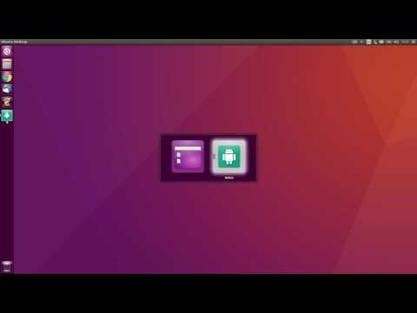
Phone emulator

Slide 34
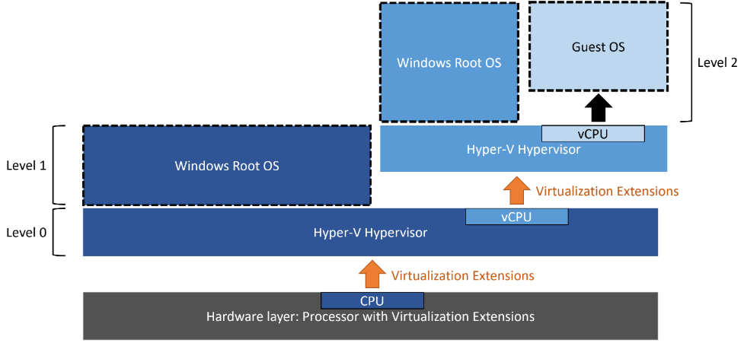
Nested Virtualization Diagram

Slide 35
Nested Virtualization Complications
Hardware Limitations
CPU allocation.
Memory allocation.
Network Connections
The host VM needs to differentiate between its own network traffic and nested VM.

Slide 36
Resources
https://docs.microsoft.com/en-us/virtualization/hyper-v-on-windows/
https://docs.microsoft.com/en-us/windows-server/administration/performance-tuning/role/hyper-v-server/storage-io-performance
https://docs.microsoft.com/en-us/windows-server/storage/disk-management/manage-virtual-hard-disks
https://docs.microsoft.com/en-us/virtualization/hyper-v-on-windows/quick-start/connect-to-network
https://docs.microsoft.com/en-us/windows-server/virtualization/hyper-v/get-started/create-a-virtual-switch-for-hyper-v-virtual-machines
https://www.veeam.com/blog/hyper-v-dynamic-memory-managing-vm-ram.html
https://www.nakivo.com/blog/hyper-v-generation-1-vs-2/
https://docs.microsoft.com/en-ca/sysinternals/downloads/process-explorer
https://superuser.com/a/1301826

Slide 37
Q & A
Notes:
In Slide Show mode, click the arrow to enter the PowerPoint Getting Started Center.

